Slide 1

Neural Photo Editing
Andrew Brock

Slide 2
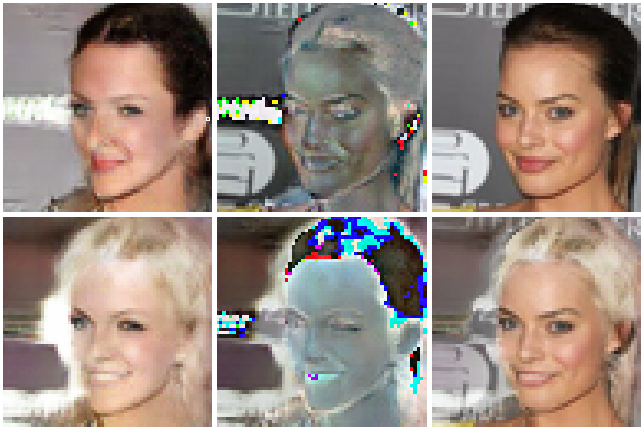
Introduction

Slide 3
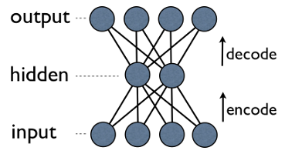
Background: VAEs

Slide 4
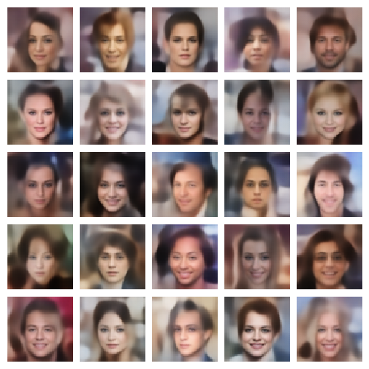
Background: VAEs

Slide 5
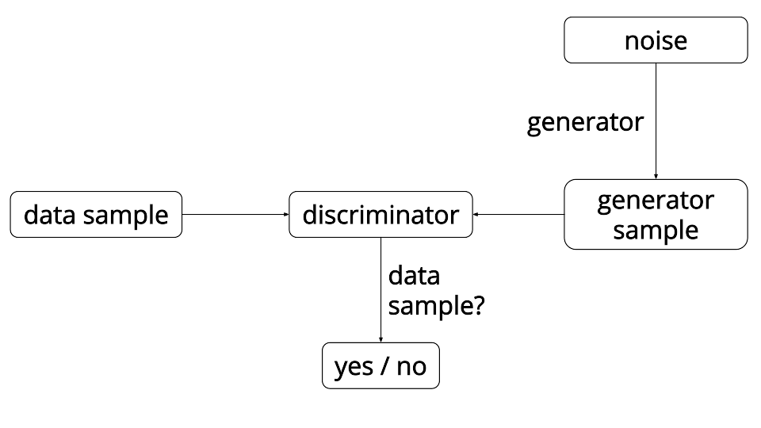
Background: GANs

Slide 6
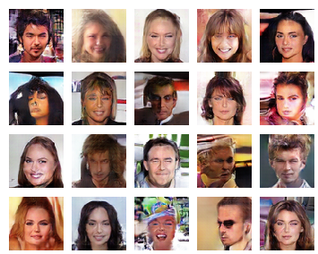
Background: GANs

Slide 7
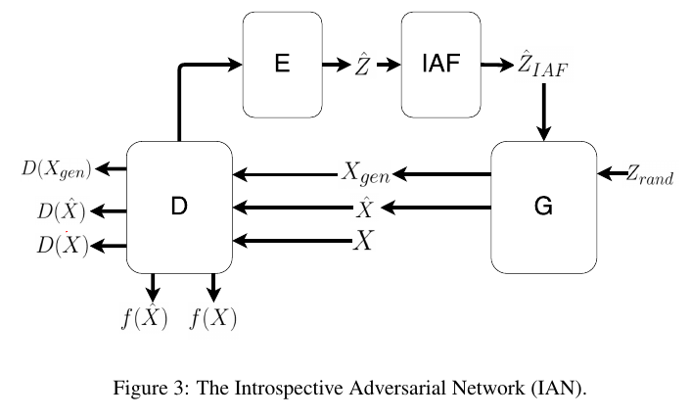
The IAN Model

Slide 8
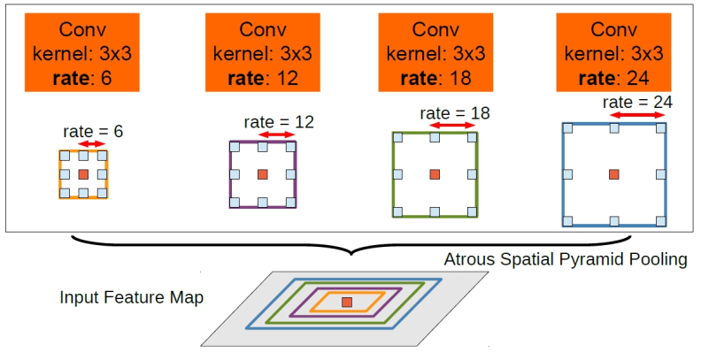
Multiscale Dilated Conv Blocks
Image credit: http://liangchiehchen.com/fig/deeplab_aspp.jpg

Slide 9
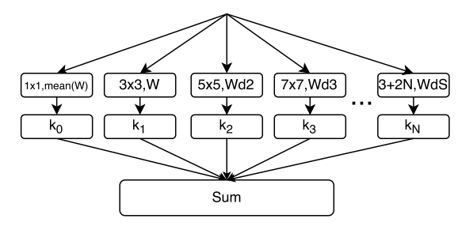
Multiscale Dilated Conv Blocks
Expressivity = range of functions a block can represent / number of parameters

Slide 10
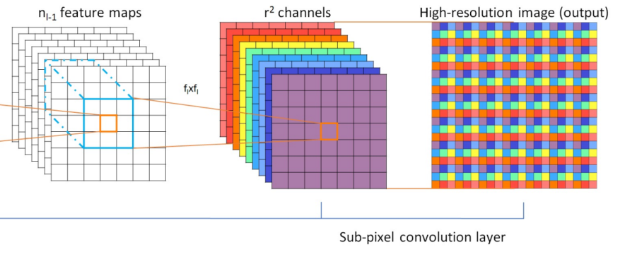
Faster Dilation through Reshapes
Image credit: Real-Time Single Image and Video Super-Resolution Using an Efficient Sub-Pixel Convolutional Neural Network, Twitter Cortex

Slide 11
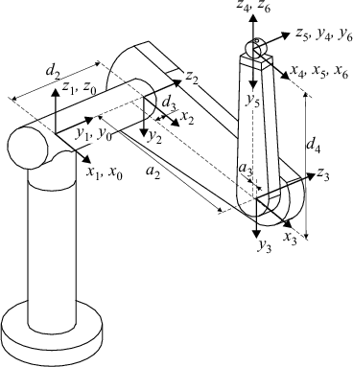
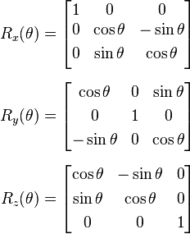
Orthogonality
Initializing weights with orthogonal matrices works well…so why not keep them orthogonal?

Slide 12

Orthogonal Regularization
Initializing weights with orthognal matrices works well…so why not keep them orthogonal?

Slide 13
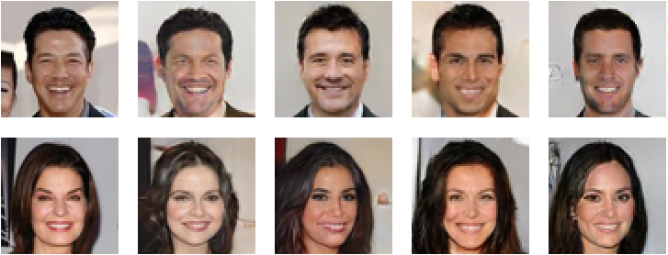
Adding Modifications

Slide 14
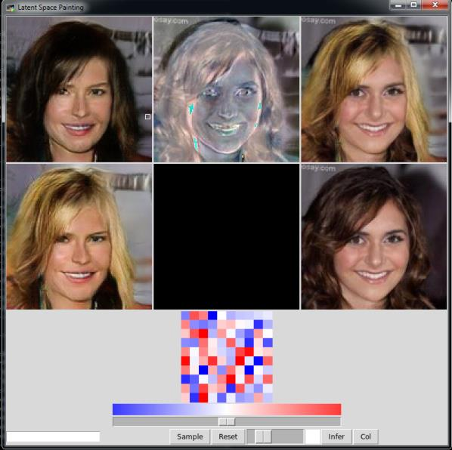
Photo Editing

Slide 15
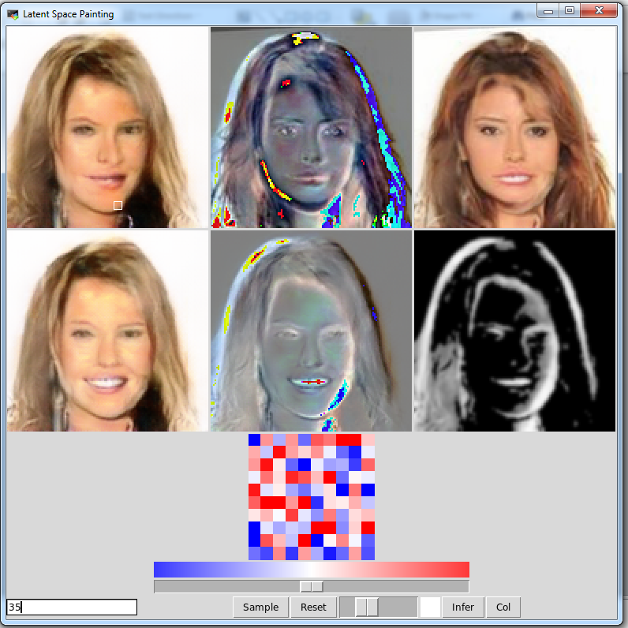
Photo Editing

Slide 16
Thanks!

Slide 17



